Slide 1

one-to-many Relationship
Infoway Technologies, 3rd Floor Commerce Centre, Rambaug Colony, Paud Road Pune 411038

Slide 2
one-to-many Relationship
A one-to-many relationship between two tables means that a row in one table can have one or more row in the table on the other side of their relationship.
Infoway Technologies, 3rd Floor Commerce Centre, Rambaug Colony, Paud Road Pune 411038

Slide 3
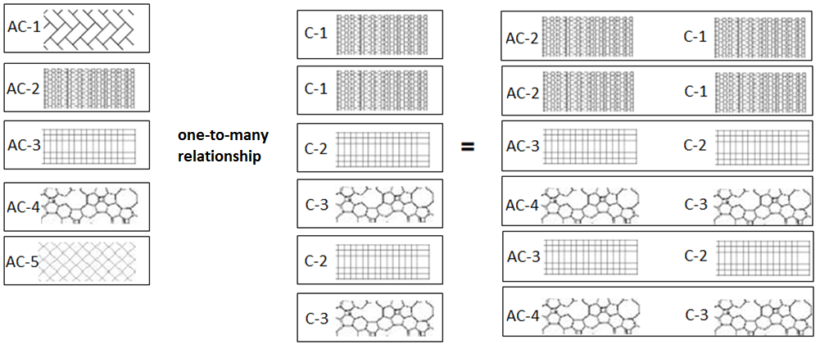
one-to-many relationship
a one-to-many relationship is a type of cardinality that refers to the relationship between two entities A and B in which an element of A may be linked to many elements of B, but a member of B is linked to only one element of A.
Infoway Technologies, 3rd Floor Commerce Centre, Rambaug Colony, Paud Road Pune 411038

Slide 4
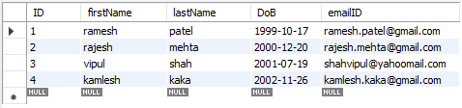
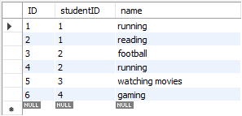
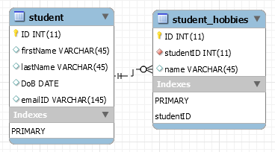

how to create one-to-many relationship
CREATE TABLE student (
ID INT(11) PRIMARY KEY,
firstName VARCHAR(45),
lastName VARCHAR(45),
DoB DATE,
emailID VARCHAR(145)
);
CREATE TABLE student_hobbies (
ID INT PRIMARY KEY,
studentID INT,
name VARCHAR(45),
FOREIGN KEY (studentID) REFERENCES student(ID)
);
Infoway Technologies, 3rd Floor Commerce Centre, Rambaug Colony, Paud Road Pune 411038

Slide 5
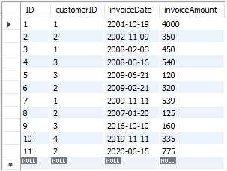
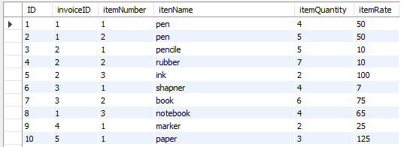
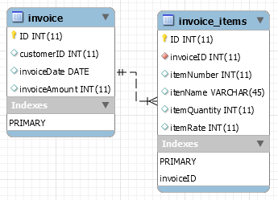

how to create one-to-many relationship
CREATE TABLE invoice (
ID INT PRIMARY KEY,
customerID INT,
invoiceDate date,
invoiceAmount INT
);
CREATE TABLE invoice_items (
ID INT PRIMARY KEY,
invoiceID INT not null,
itemNumber INT,
itenName VARCHAR(45),
itemQuantity INT,
itemRate INT,
FOREIGN KEY (invoiceID) REFERENCES invoice(ID)
);
Infoway Technologies, 3rd Floor Commerce Centre, Rambaug Colony, Paud Road Pune 411038

